Slide 1

APEX INSTITUTE OF TECHNOLOGY
DEPARTMENT OF COMPUTER SCIENCE & ENGINEERING
DEEP LEARNING (20CSF-432)
Faculty: Prof. (Dr.) Madan Lal Saini(E13485)
Lecture – 7
Activation Functions
DISCOVER . LEARN . EMPOWER

Slide 2
Deep Learning: Course Objectives
COURSE OBJECTIVES
The Course aims to:
Understand the key features in a neural network’s architecture
Understand the main fundamentals that drive Deep Learning
Be able to build, train and apply fully connected deep neural networks
Know how to implement efficient CNN or RNN.
Implementation the fundamental methods involved in deep learning, including the underlying optimization concepts (gradient descent and backpropagation) and how they can be combined to solve real-world problems.

Slide 3
COURSE OUTCOMES
On completion of this course, the students shall be able to:-
CO1 | Understand neural network, its working and parameters, and various deep neural network architectures.
CO2 | Differentiate between the major types of neural network architectures (multi-layered perceptron, convolutional neural networks, recurrent neural networks, etc.) and what types of problems can be solved by these architectures.
CO3 | Evaluate the performance of deep neural network and improve the performance by applying optimization techniques.
CO4 | Design or select neural network architectures for new data problems based on their requirements and problem characteristics and analyse their performance.
CO5 | Describe some of the latest research being conducted in the field and open problems that are yet to be solved.

Slide 4
Unit-1 Syllabus
Unit-1 | Artificial Neural Network
Fundamentals of Neural Network | Introduction to Neural Network, Model of Artificial Neuron, Multilayer Perceptron, Back Propagation, Learning rules and various activation functions, Gradient descent, Stochastic Gradient descent.
Neural Network Architecture | Single layer Feed-forward networks. Multi-layer Feed-forward networks. Architecture of Back-propagation (BP) Networks, Backpropagation Learning.
Training Neural Network | Training Deep Neural Networks using Back Propagation-Setup and initialization issues, Gradient- Descent Strategies, vanishing and exploding Gradient problems, regularizations, and dropouts.

Slide 5
SUGGESTIVE READINGS
TEXT BOOKS:
T1: Deep Learning with Python by Francois Chollet, Publisher: Manning Publications
T2: Deep Learning from Scratch: Building with Python from First Principles by Seth Weidman published by O`Reilley
T3: Deep Learning by Ian Goodfellow, Yoshua Bengio and Aaron Courville published by MIT Press.
REFERENCE BOOKS:
R1 Fundamentals of Deep Learning: by Nithin Buduma, Nikhil Buduma and Joe Papa, OREILLY Publication, Second Edition.
R2 Deep Learning: A Practitioners Approach by Josh Patterson and Adam Gibson, OREILLY Publication.
R3 Deep Learning for Coders with fastai and PyTorch by Jeremy Howard and Sylvain Gugger, OREILLY Publication.
R4 Deep Learning Using Python by S Lovelyn Rose, L Ashok Kumar, D Karthika Renuka, Wiley Publication

Slide 6
Table of Contents
Neural network and its working
Activation functions for neural network.

Slide 7
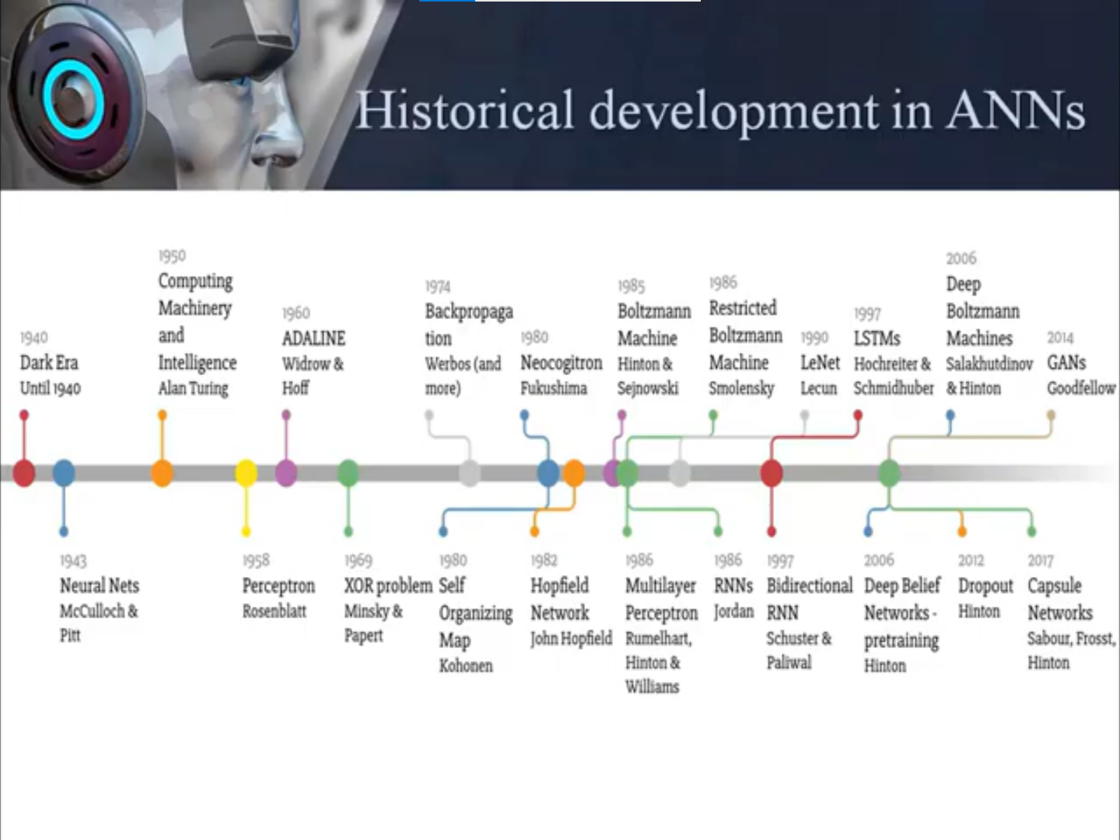

Slide 8
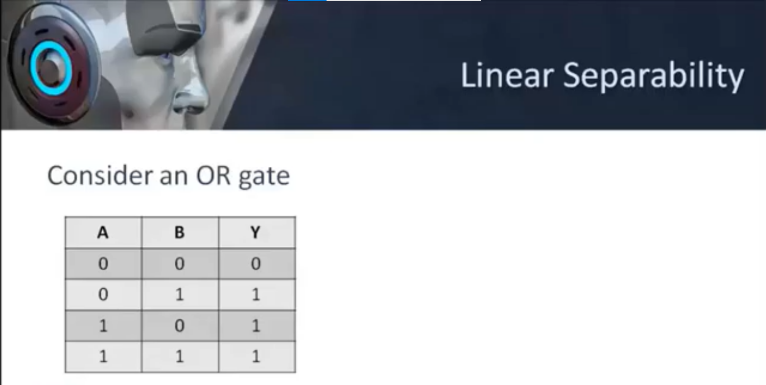

Slide 9
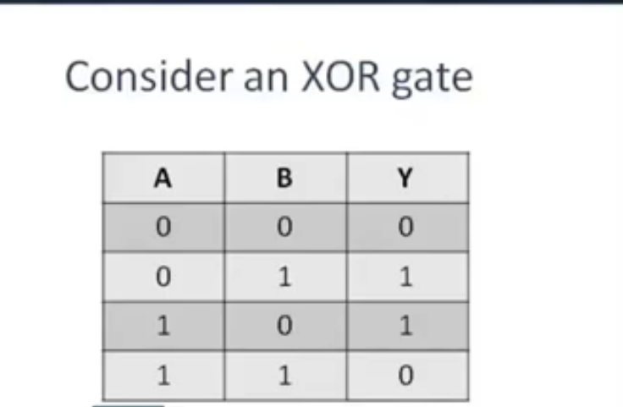

Slide 10
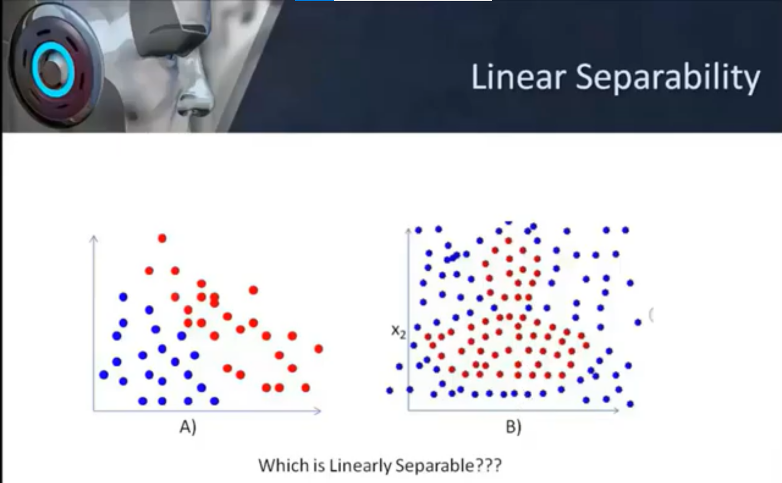
http://vlabs.iitkgp.ac.in/scte/exp5/perceptron-js-simulator.html

Slide 11
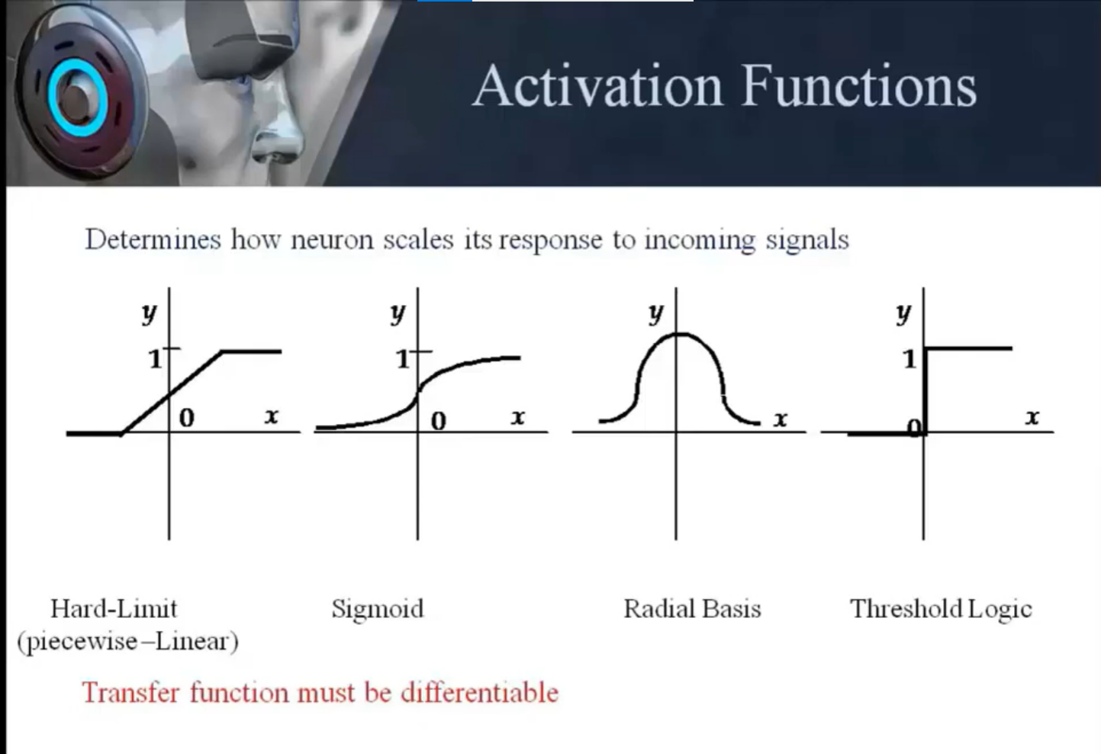

Slide 12
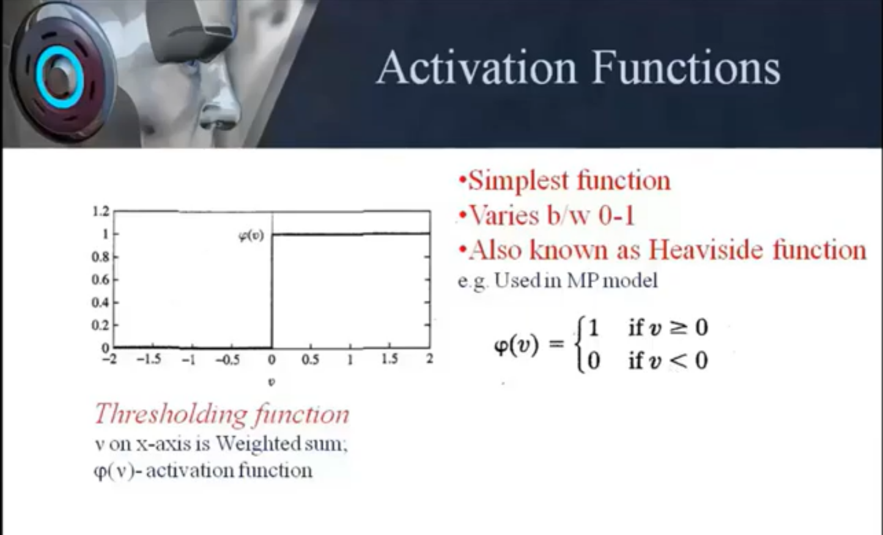

Slide 13
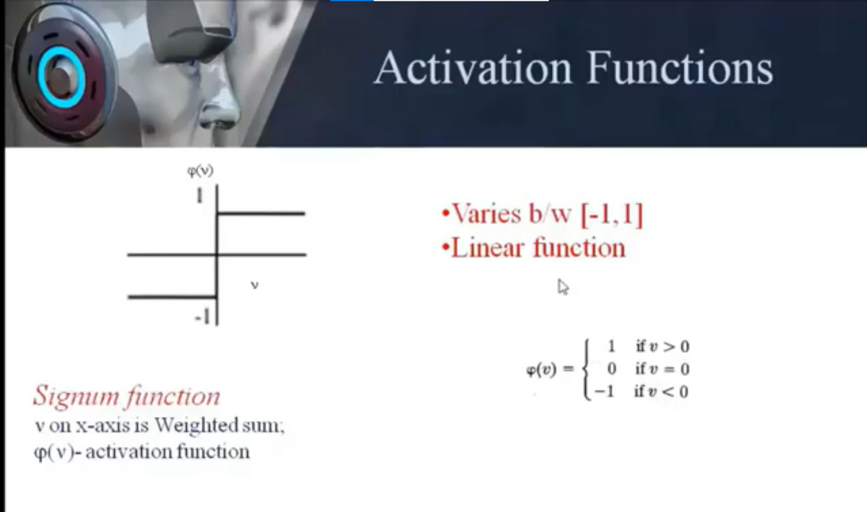

Slide 14
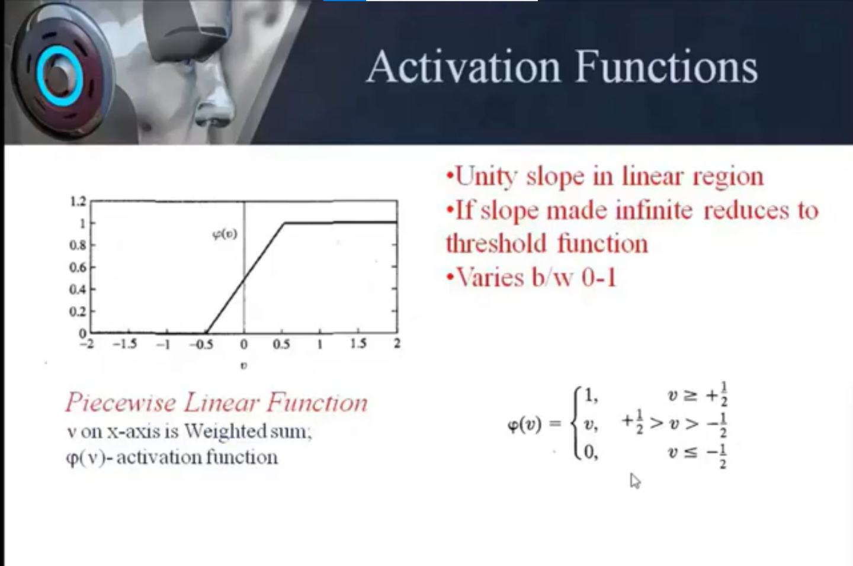

Slide 15
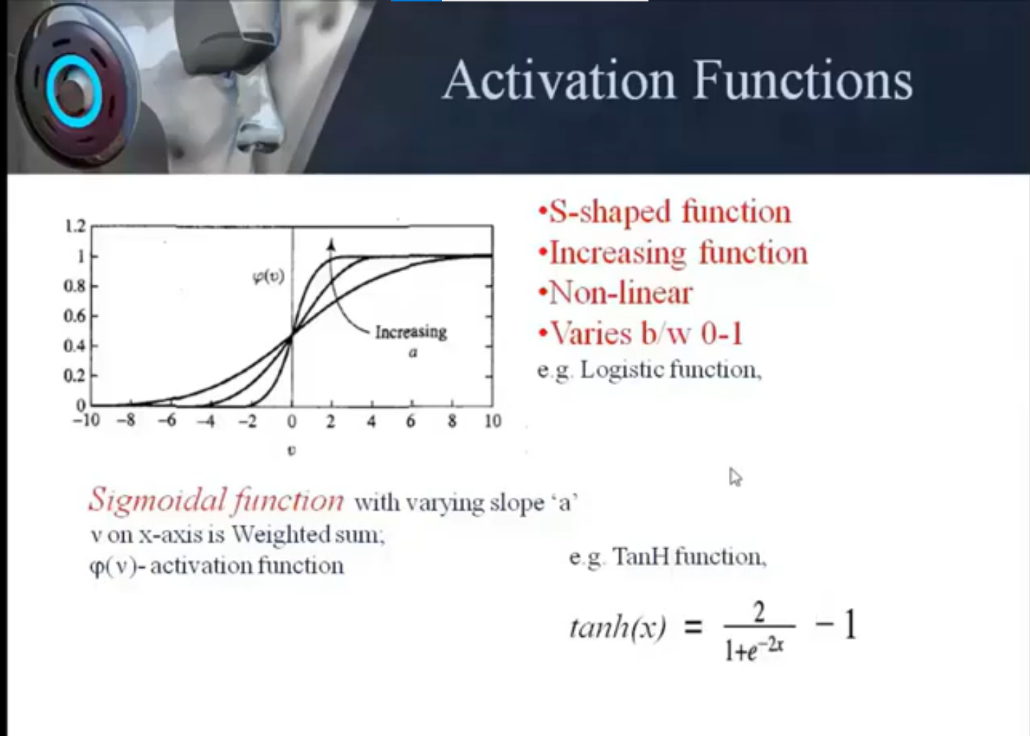

Slide 16
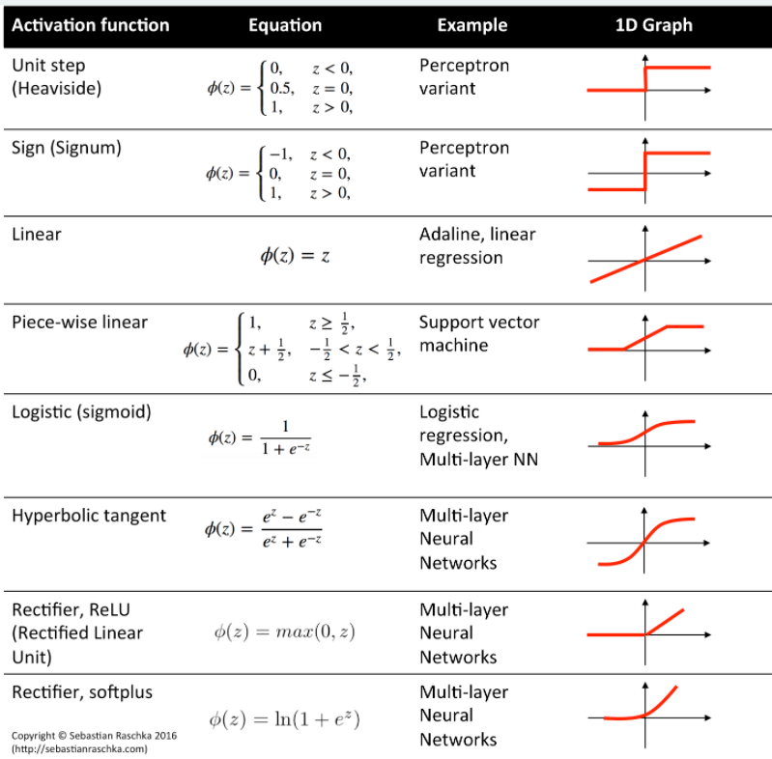

Slide 17
References
Main text books:
• “Neural Networks: A Comprehensive Foundation”, S. Haykin (very
good -theoretical)
• “Pattern Recognition with Neural Networks”, C. Bishop (very goodmore
accessible)
• “Neural Network Design” by Hagan, Demuth and Beale
(introductory)
Books emphasizing the practical aspects:
• “Neural Smithing”, Reeds and Marks
• “Practical Neural Network Recipees in C++”’ T. Masters
• Seminal Paper (but now quite old!):
– “Parallel Distributed Processing” Rumelhart and McClelland et al.
Deep Learning books and tutorials:
• http://www.deeplearningbook.org/
Introduction to Learning Rules in Neural Network - DataFlair (data-flair.training)

Slide 18
Neural Networks Literature
Review Articles:
R. P. Lippman, “An introduction to Computing with Neural Nets”’ IEEE
ASP Magazine, 4-22, April 1987.
T. Kohonen, “An Introduction to Neural Computing”, Neural Networks,
1, 3-16, 1988.
A. K. Jain, J. Mao, K. Mohuiddin, “Artificial Neural Networks: A Tutorial”’
IEEE Computer, March 1996’ p. 31-44.
Journals:
IEEE Transactions on NN
Neural Networks
Neural Computation
Biological Cybernetics

Slide 19
THANK YOU
For queries
Email: madan.e13485@cumail.in

